Slide 1
Asset Management & Access Control
Faisal Iradat

Slide 2
Assets
Anything deemed valuable to a company is considered an asset:
People
Information
Data
Hardware
Software
Processes
Ideas
Etc.
You can’t effectively protect your organization if you don’t know what you have. Therefore, assets should be identified and classified so they can be effectively protected.

Slide 3
Asset Identification & Classification Process
1. Inventory Your
Assets
2. Assign
Ownership
3. Classify
Based on Value
4. Protect Based
on Value
Classification
5. Periodically
Assess &
Review

Slide 4
The Asset Lifecycle
1. Identify & Classify
New assets should be identified and classified.
2. Secure
Secure assets based on the classified value.
3. Monitor
Regularly monitor for changes in value and the effectiveness of our security controls.
4. Recovery
If an asset if adversely impacted, recovery measures should in place.
5. Disposition
Once the usefulness of an asset been reached and it is to be disposed, there are two primary methods: archiving the asset for long term storage or defensible destruction , ensuring there is no data remanence.

Slide 5
Data Retention
Data retention is the long term storage of valuable assets, typically driven by
Legal and Regulatory Compliance Requirements
Organizational Requirements
Retaining sensitive information poses a risk to the organization because of data breaches and threats of disclosure.
2017 Equifax Data Breach of 145.5 million U.S. consumers cost the company $1.4 billion
2013 Target Customer Credit/Debit Card Data Breach of 70 million customers cost the company $162 million
Therefore, sensitive information should only be retained as long as it is useful or required by law.
Organizations can do so by developing a records retention policy based on legal, regulatory, and organizational requirements.

Slide 6
Data States
Data State | Details
Data at Rest | Data that’s stored on media of any form (hard drive, USB stick, tape, CD). It’s considered at rest because it’s not being transmitted over the network or in use. Data at rest is commonly protected by disk and file encryption.
Data in Motion | Data that’s currently moving across a network from one device to another. Data in motion is commonly protected by network encryption, such as SSL, TLS, and VPN connections with IPSec encryption.
Data in Use | Data that’s being used by a system process, application or user. It’s data that’s being created, updated, appended, or erased. Data in use is the hardest to protect because it’s not encrypted while in use. Proper access control, integrity checks, and auditing measures can help protect data in use.

Slide 7
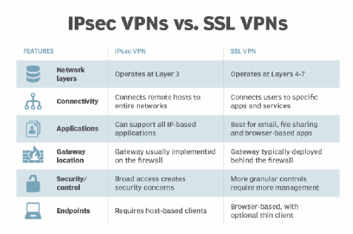
Data in Motion

Slide 8
Data in Motion

Slide 9
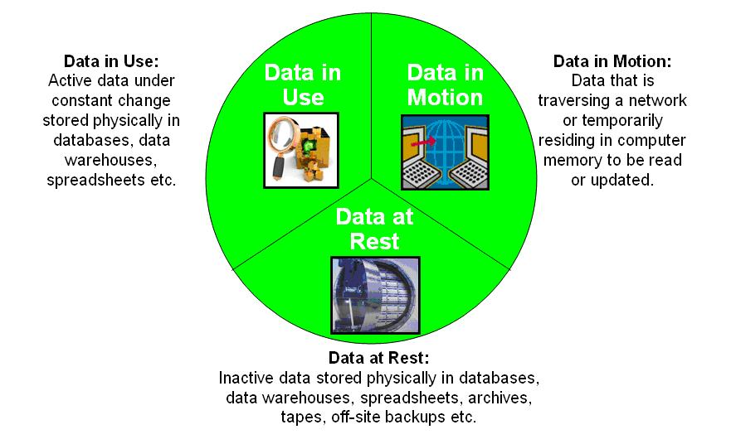
Data States

Slide 10
Access Control
Access Control Basics
Access control protects against a wide variety of threats:
Unauthorized Access
Unapproved Modification of Data
Lack of Data Confidentiality
CIA triad is the cornerstone of cyber security and access control.

Slide 11
Access Control Categories & Types
Access Control
Preventive
Detective
Corrective
Recovery
Deterrent
Compensating

Slide 12
Access Control Categories & Types
Preventative Controls prevent actions.
Background check before approving a tenant ensures a qualified tenant.
Drug test before employment prevents the hiring of employees that use illegal drugs.
Detective Controls send alerts during or after an attack.
Building alarm triggered during a break in.
Network intrusion detection system (IDS) alerting network administrators of an attack.

Slide 13
Access Control Categories & Types
Corrective Controls “correct” a damaged system or process.
Anti virus can quarantine and delete malicious software from a computer system.
Intrusion prevention system (IPS) can stop a network attack by blocking it.
Recovery Controls are needed to restore functionality.
Restoring corrupted data with a data backup.
A secondary office site can restore business functionality after a natural disaster to the business’s primary site.

Slide 14

Access Control Categories & Types
Deterrent Controls deter users from performing actions.
Security guards.
A “beware of dog” sign.
A fence around your building.
Compensating Controls add additional security.
Defense In Depth
Multiple Layers of Security

Slide 15
Physical & Logical Access Control
Physical security includes implementing different access control methods with technology you can touch.
Physically locking down the equipment and securing the building.
Logical security methods include those elements that are implemented through technological means.
Password policies, logical access control lists, etc.

Slide 16
Common Physical Access Controls
Employee ID Badges
Physical Access Logs
Door Access Systems
Proximity Cards
Mantraps
Hardware Locks
Video Surveillance
Security Guards
Building Alarms
Fences

Slide 17
Mantraps
y2mate.com - Tailgating access control biometric fingerprint identification_v240P.mp4
y2mate.com - Mantrap with tailgating_v240P.mp4
https://www.youtube.com/watch?v=z6fETP1up88
https://www.youtube.com/watch?v=yrjT8m0hcKU

Slide 18
Common Logical Access Controls
Access Control Lists
Windows Group Policies
Password Policies
Account Policies
Device Policies

